Slide 1
SURF 2024 – 7th Meeting
Ryan Hsieh 2024/07/05

Slide 2
AGENDA
Optimization Model - Power Flow Studies relationship with BreakThrough Energy
BreakThrough Grid Data vs EPA Data

Slide 3
Power flow studies
Optimal Power Flow (Load Flow) analysis : determine the optimal operating conditions for power system
Aiming...:
Minimizing : generation cost, power loss, or environmental impact
Satisfying : set of constraints
Power balance, voltage limit, or generation limit
Outputs : Optimal generation dispatch, bus voltages, and power flow on transmission lines
Reduced Power Flow analysis : Simplified power flow analysis method = reduces complexity of full power flow problem
Aiming...:
Making : Approximation or assumptions to streamline the computation
Quick analysis & decision making when the full power flow study is too time consuming
Outputs : Not accurate enough comparing to OPF = only use as insights

Slide 4
Breakthrough Energy Packages
REISE.jl
2. PowerSimData
3. PostREISE
Julia-based tool for renewable energy integration simulation
Python-based tool creating & managing simulation scenarios for power system analysis
Post processing tool that works with REISE.jl & PowerSimData
Large scale power systems & optimizing the integration of renewable sources
Bridge between data management, scenario creationg, and simluation execution
Provides function for analysis, visualizations, interpreting results of simulations
DC-OPF
Simplifies AC Power Flow equations by making linear approximations ==> reduce computational complexity while providing accurate results for high-level planning & optimization study
Leveraging efficiency & scalability of handling large datasets and complex scenarios

Slide 5
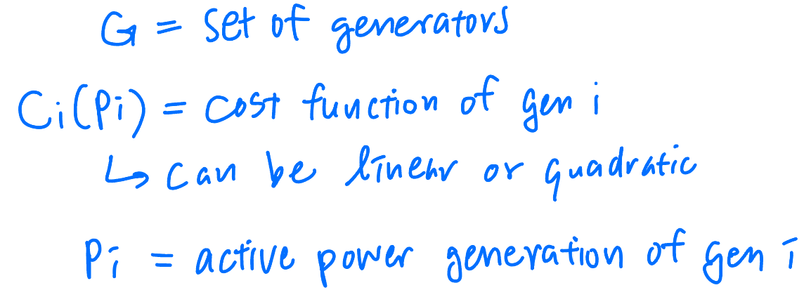
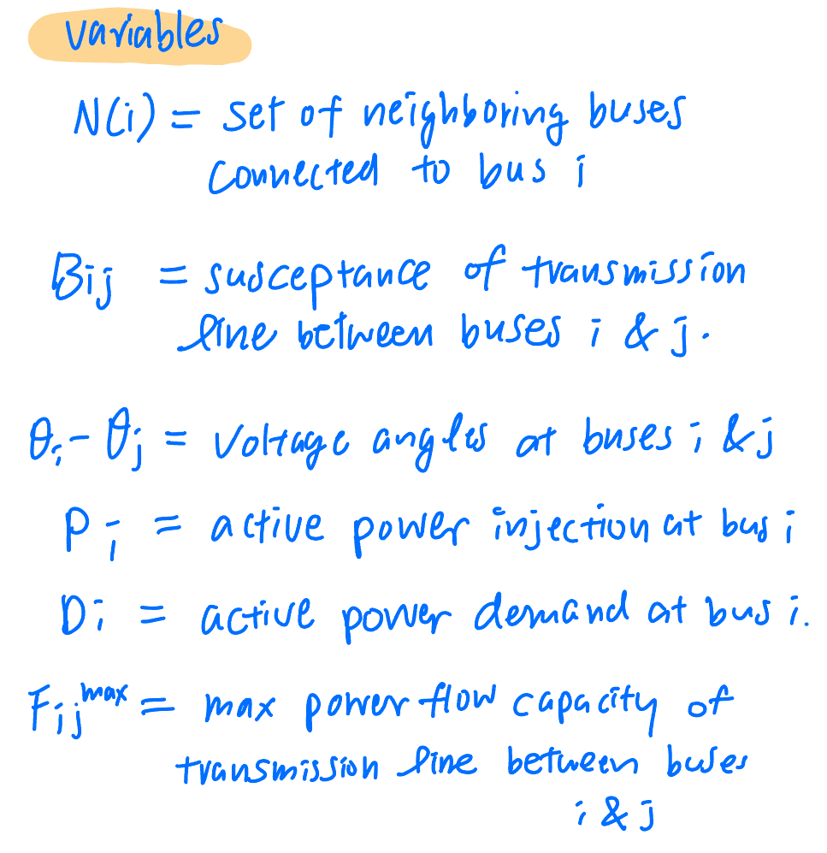
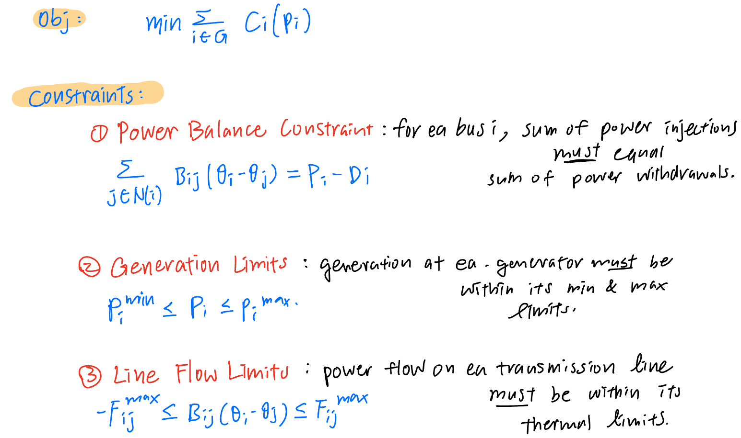
Proof to be DC-opF
Three Major Assumptions:
Voltage Magnitude: Voltage magnitudes are assumed to be constant and close to 1.0 per unit.
Voltage Angles: Voltage angle differences between buses are assumed to be small.
Reactive Power: Reactive power and losses are ignored.

Slide 6
Breakthrough Grid Data vs EPA Data
Generation of Energy data

Slide 7
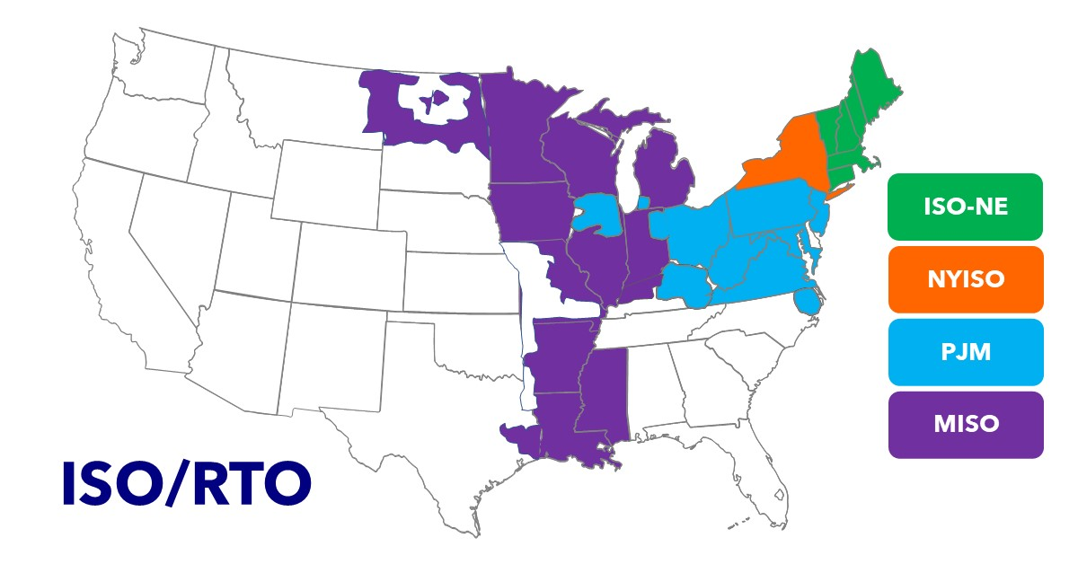
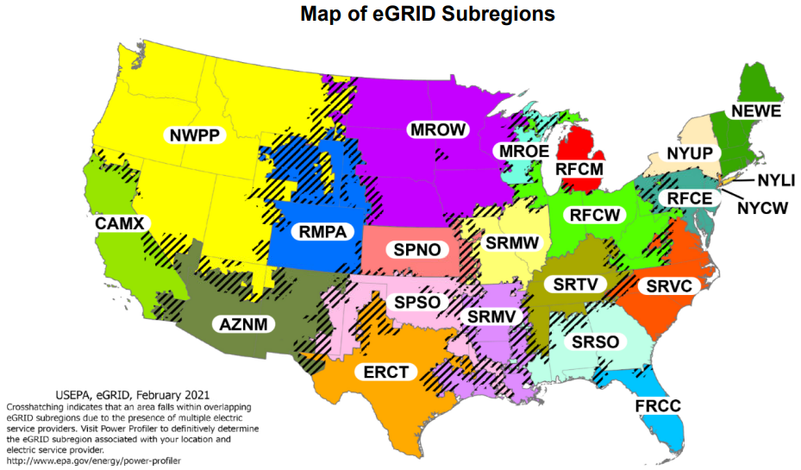
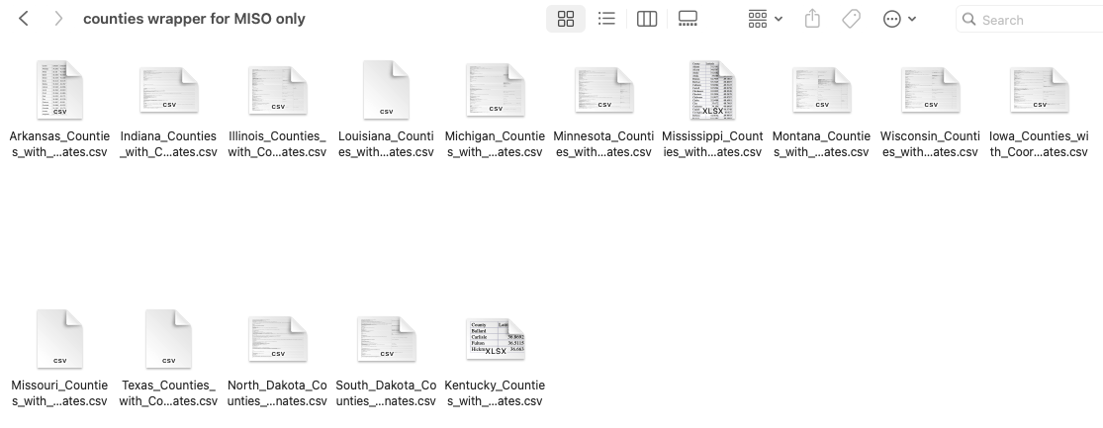
Miso regions vs. EPA regions
Focus on MISO region including states:
Completed States:
Arkansas ---> 75 counties
Illinois ---> 102 counties
Indiana ---> 92 counties
Iowa ---> 99 counties
Louisiana ---> 64 counties
Michigan ---> 83 counties
Minnesota ---> 87 counties
Mississippi ---> 82 counties
Montana ---> 56 counties
Wisconsin ---> 72 counties
Partial States:
Kentucky ---> 4 counties only
Missouri ---> 15 counties only
N. Dakota ---> 5 counties only
S. Dakota ---> 6 counties only
Texas ---> 14 counties only

Slide 8
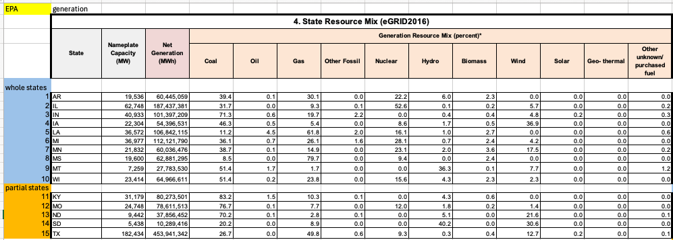
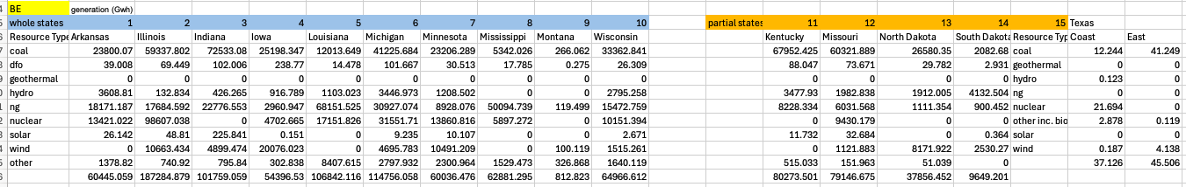
Gen Data Comparison
Generation Data from EPA
More detailed w/ percentage cover
MWh
Generation Data from BE
- Gwh

Slide 9
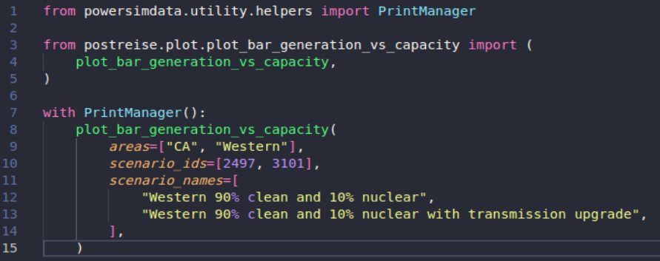
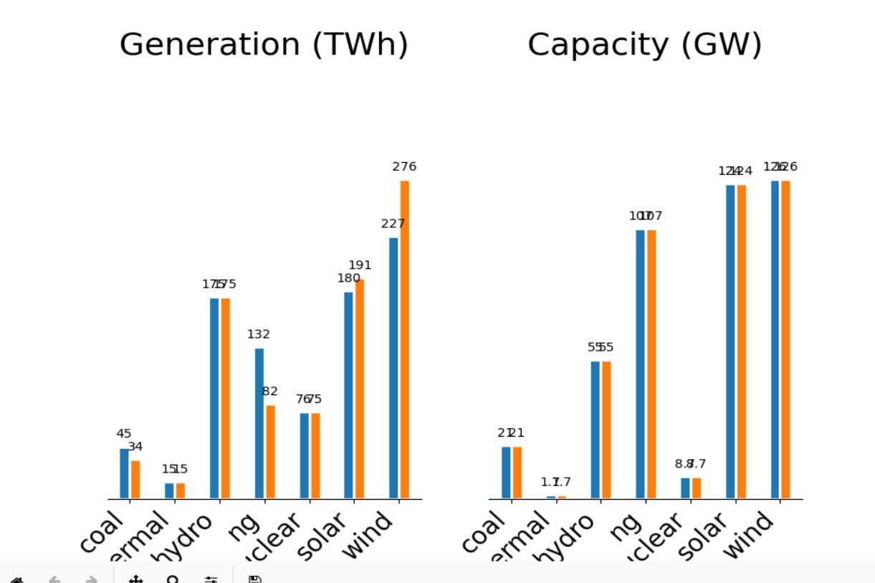
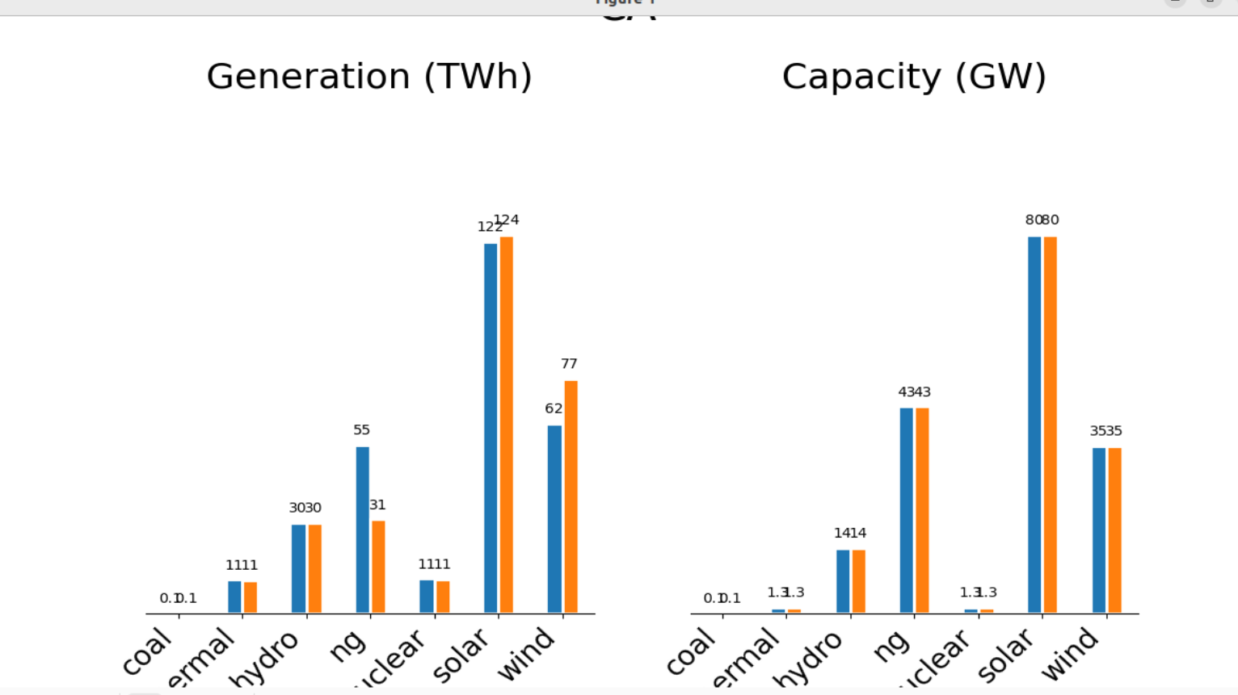
PostREise
PostReise generated plot
These are the sample bar plots for generation vs capacity of all types of energy in CA and Western Region

